Slide 1
ASSIGNMENT BASED SUBJECTIVE-QUESTIONS
1. From your analysis of the categorical variables from the dataset, what could you infer about their effect on the dependent variable? (3 marks)
Answer:
The demand for bikes is less in the month of spring when compared with other seasons
The demand for bikes increased in the year 2019 when compared with the year 2018.
Month of Jun to Sep is the period when bike demand is high. The Month Jan is the lowest demand month.
Bike demand is less in holidays in comparison to not being holidays.
The demand for bikes is almost similar throughout the weekdays.
There is no significant change in bike demand with the working day and non-working day.
The bike demand is high when the weather is clear and Few clouds however demand is less in the case of Light snow and light rainfall.
We do not have any data for Heavy Rain + Ice Pallets + Thunderstorm + Mist, Snow + Fog, so we can not derive any conclusion.
Maybe the company is not operating on those days or there is no demand for bikes.

Slide 2
2. Why is it important to use drop_first=True during dummy variable creation? (2 marks)
Answer- Hence, Drop_first=True is important to use, as it helps in reducing the extra column created during dummy variable creation. Hence it reduces the correlation created among dummy variables.
3. Looking at the pair-plot among the numerical variables, which one has the highest correlation with the target variable? (1 mark)
Answer-The numerical variable 'registered' has the highest correlation with the target variable 'cnt', if we consider all the features. But after data preparation, when we drop registered due to multi-collinearity the numerical variable 'atemp' has the highest correlation with the target variable 'cnt’.
4. How did you validate the assumptions of Linear Regression after building the model on the training set? (3 marks)
Answer- The simple way to determine if this assumption is met or not is by creating a scatter plot x vs y. If the data points fall on a straight line in the graph, there is a linear relationship between the dependent and the independent variables, and the assumption holds.
5. Based on the final model, which are the top 3 features contributing significantly towards explaining the demand of the shared bikes? (2 marks)
Answer- 1.Temperature (0.552)
2.weathersit : Light Snow, Light Rain + Thunderstorm + Scattered clouds, Light Rain + Scattered clouds (-0.264)
3.year (0.256)

Slide 3
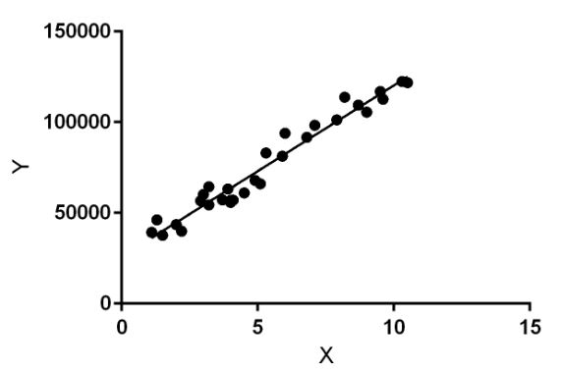
General Subjective Questions
Explain the linear regression algorithm in detail. (4 marks)
Answer- Linear Regression is a machine learning algorithm based on supervised learning. It performs a regression task. Regression models a target prediction value based on independent variables. It is mostly used for finding out the relationship between variables and forecasting. Different regression models differ based on – the kind of relationship between the dependent and independent variables they are considering, and the number of independent variables getting used.

Slide 4
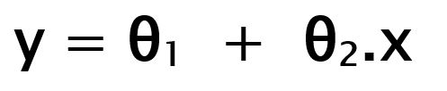
Linear regression performs the task to predict a dependent variable value (y) based on a given independent variable (x). So, this regression technique finds out a linear relationship between x (input) and y(output). Hence, the name is Linear Regression. In the figure above, X (input) is the work experience and Y (output) is the salary of a person. The regression line is the best fit line for our model.
Hypothesis function for Linear Regression :
While training the model we are given : x: input training data (univariate – one input variable(parameter)) y: labels to data (supervised learning)
When training the model – it fits the best line to predict the value of y for a given value of x. The model gets the best regression fit line by finding the best θ₁ and θ₂ values. θ₁: intercept θ₂: coefficient of x
Once we find the best θ₁ and θ₂ values, we get the best fit line. So when we are finally using our model for prediction, it will predict the value of y for the input value of x.

Slide 5


How to update θ₁ and θ₂ values to get the best fit line?
Cost Function (J): By achieving the best-fit regression line, the model aims to predict the y value such that the error difference between the predicted value and the true value is minimum. So, it is very important to update the θ₁ and θ₂ values, to reach the best value that minimizes the error between the predicted y value (pred) and true y value (y).
Cost function(J) of Linear Regression is the Root Mean Squared Error (RMSE) between the predicted y value (pred) and true y value (y).
Gradient function-
To update θ₁ and θ₂ values in order to reduce Cost function (minimizing RMSE value) and achieve the best fit line the model uses Gradient Descent. The idea is to start with random θ₁ and θ₂ values and then iteratively updating the values, reaching minimum cost.

Slide 6
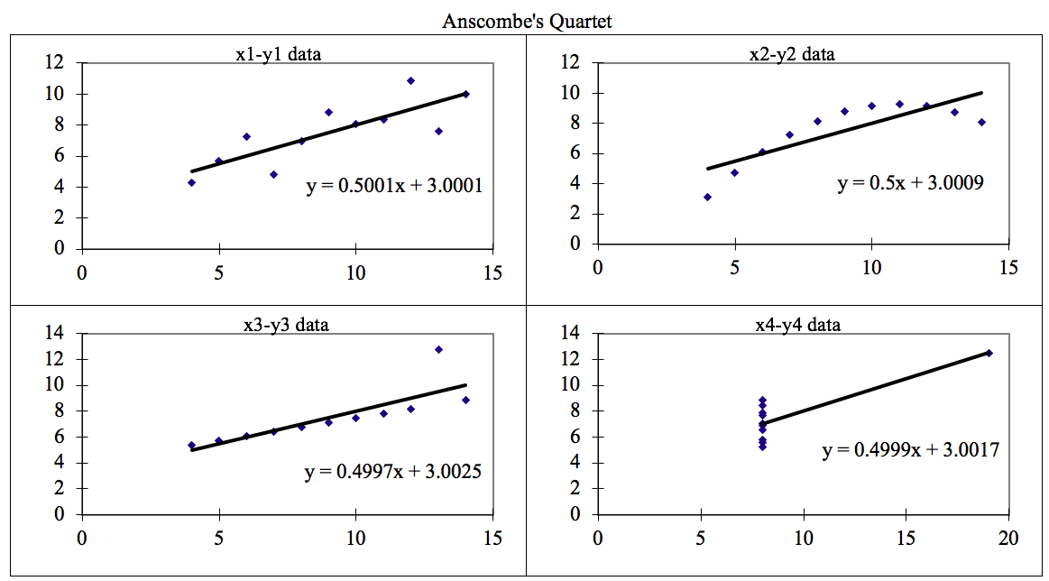
2. Explain Anscombe’s quartet in detail. (3 marks)
Anwer-Four datasets that fool the Linear Regression model if built.

Slide 7
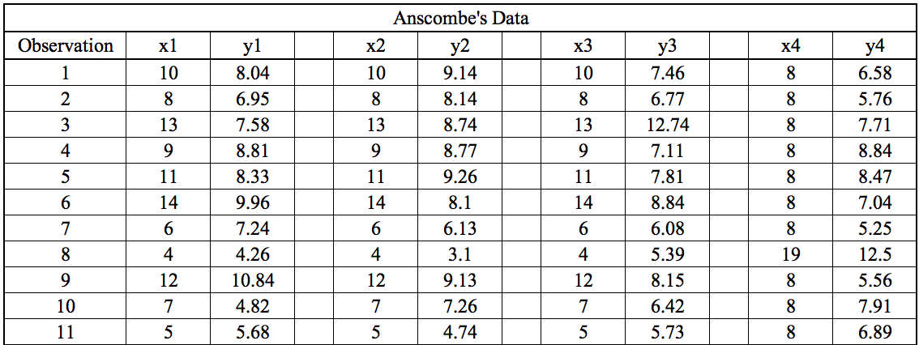
Anscombe’s Quartet can be defined as a group of four data sets that are nearly identical in simple descriptive statistics, but there are some peculiarities in the dataset that fools the regression model if built. They have very different distributions and appear differently when plotted on scatter plots.
It was constructed in 1973 by statistician Francis Anscombe to illustrate the importance of plotting the graphs before analyzing and model building, and the effect of other observations on statistical properties. There are these four data set plots that have nearly the same statistical observations, which provide the same statistical information that involves variance and mean of all x, and y points in all four datasets.
This tells us about the importance of visualizing the data before applying various algorithms out there to build models out of them which suggests that the data features must be plotted in order to see the distribution of the samples that can help you identify the various anomalies present in the data like outliers, diversity of the data, linear separability of the data, etc. Also, Linear Regression can only be considered a fit for the data with linear relationships and is incapable of handling any other kind of dataset. These four plots can be defined as follows:

Slide 8
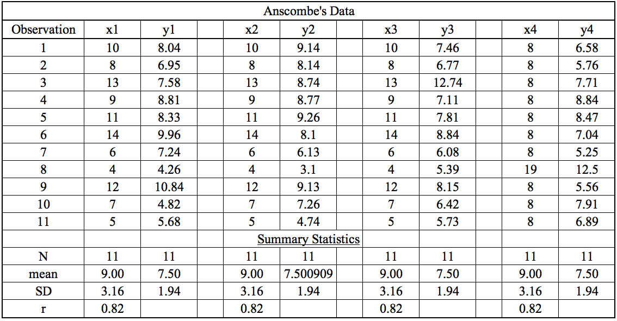
The statistical information for all these four datasets are approximately similar and can be computed as follows:

Slide 9
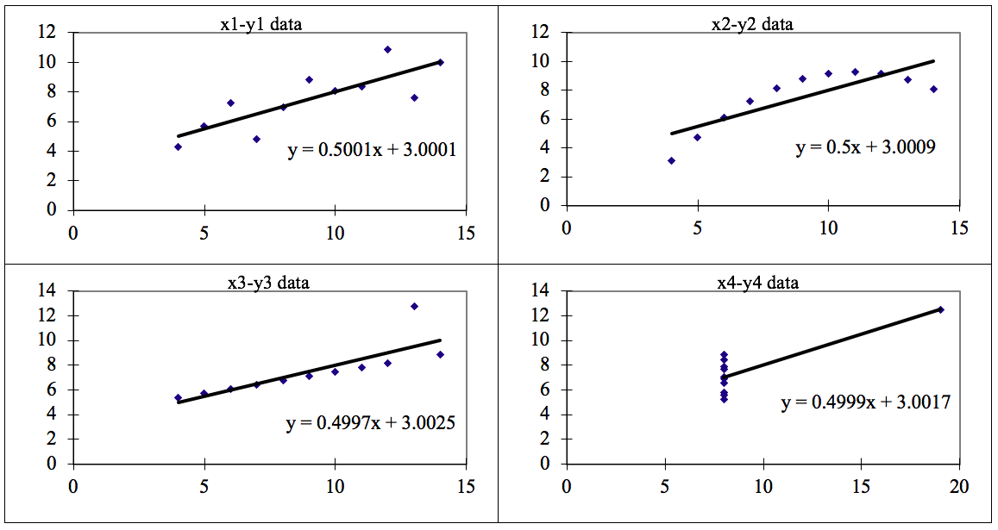
When these models are plotted on a scatter plot, all datasets generates a different kind of plot that is not interpretable by any regression algorithm which is fooled by these peculiarities and can be seen as follows:

Slide 10
The four datasets can be described as:
Dataset 1: this fits the linear regression model pretty well.
Dataset 2: this could not fit the linear regression model on the data quite well as the data is non-linear.
Dataset 3: shows the outliers involved in the dataset which cannot be handled by the linear regression model
Dataset 4: shows the outliers involved in the dataset which cannot be handled by a linear regression model
Conclusion:
We have described the four datasets that were intentionally created to describe the importance of data visualization and how any regression algorithm can be fooled by the same. Hence, all the important features in the dataset must be visualized before implementing any machine learning algorithm on them which will help to make a good fit model.

Slide 11
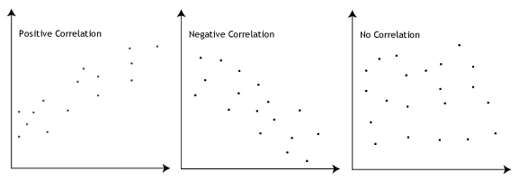
3. What is Pearson’s R? (3 marks)
Answer-In statistics, the Pearson correlation coefficient (PCC), also referred to as Pearson's r, the Pearson product-moment correlation coefficient (PPMCC), or the bivariate correlation, is a measure of linear correlation between two sets of data. It is the covariance of two variables, divided by the product of their standard deviations; thus it is essentially a normalised measurement of the covariance, such that the result always has a value between −1 and 1.
The Pearson's correlation coefficient varies between -1 and +1 where:
r = 1 means the data is perfectly linear with a positive slope ( i.e., both variables tend to change in the same direction)
r = -1 means the data is perfectly linear with a negative slope ( i.e., both variables tend to change in different directions)
r = 0 means there is no linear association
r > 0 < 5 means there is a weak association
r > 5 < 8 means there is a moderate association
r > 8 means there is a strong association

Slide 12
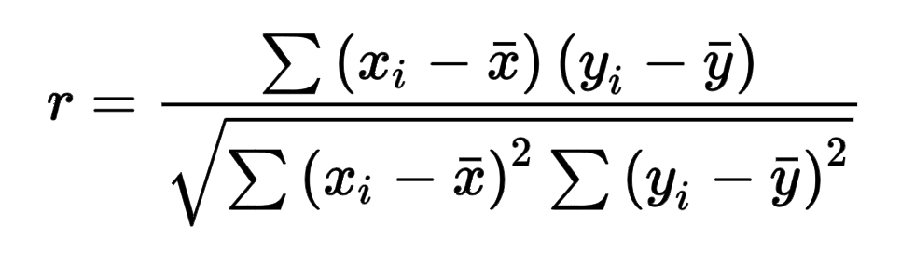
Pearson r formula
Here,
=correlation coefficient
=values of the x-variable in a sample
=mean of the values of the x-variable
=values of the y-variable in a sample
=mean of the values of the y-variable

Slide 13

4. What is scaling? Why is scaling performed? What is the difference between normalized scaling and standardized scaling?
(3 marks)
Answer-
What?
It is a step of data Pre-Processing that is applied to independent variables to normalize the data within a particular range. It also helps in speeding up the calculations in an algorithm.
Why?
Most of the time, the collected data set contains features highly varying in magnitudes, units and range. If scaling is not done then the algorithm only takes magnitude into account and not units hence incorrect modeling. To solve this issue, we have to do scaling to bring all the variables to the same level of magnitude.
It is important to note that scaling just affects the coefficients and none of the other parameters like t-statistic, F-statistic, p-values, R-squared, etc.
Normalization/Min-Max Scaling:
It brings all of the data in the range of 0 and 1. sklearn.preprocessing.MinMaxScaler helps to implement normalization in python.

Slide 14

Standardization Scaling:
Standardization replaces the values by their Z scores. It brings all of the data into a standard normal distribution which has mean (μ) zero and standard deviation one (σ).
sklearn.preprocessing.scale helps to implement standardization in python.
One disadvantage of normalization over standardization is that it loses some information in the data, especially about outliers.

Slide 15
5. You might have observed that sometimes the value of VIF is infinite. Why does this happen? (3 marks)
Answer-
If there is a perfect correlation, then VIF = infinity. This shows a perfect correlation between two independent variables. In the case of perfect correlation, we get R2 =1, which leads to 1/(1-R2) infinity. To solve this problem we need to drop one of the variables from the dataset which is causing this perfect multicollinearity.
An infinite VIF value indicates that the corresponding variable may be expressed exactly by a linear combination of other variables (which show an infinite VIF as well).

Slide 16
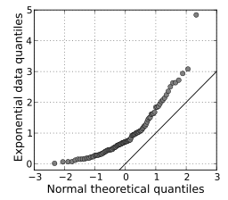
6. What is a Q-Q plot? Explain the use and importance of a Q-Q plot in linear regression. (3 marks)
Answer-Q-Q Plots (Quantile-Quantile plots) are plots of two quantiles against each other. A quantile is a fraction where certain values fall below that quantile. For example, the median is a quantile where 50% of the data falls below that point and 50% lies above it. The purpose of Q Q plots is to find out if two sets of data come from the same distribution. A 445-degreeangle is plotted on the Q Q plot; if the two data sets come from a common distribution, the points will fall on that reference line.
A Q Q plot showing the 45-degree reference line:

Slide 17
If the two distributions being compared are similar, the points in the Q–Q plot will approximately lie on the line y = x. If the distributions are linearly related, the points in the Q–Q plot will approximately lie on a line, but not necessarily on the line y = x. Q–Q plots can also be used as a graphical means of estimating parameters in a location-scale family of distributions.
A Q–Q plot is used to compare the shapes of distributions, providing a graphical view of how properties such as location, scale, and skewness are similar or different in the two distributions.

